Slide 1
System & Devices
QAS | XPD
Windows 10 64-bit | Windows 10 64-bit
XRO 1620 xN CS(2048 x 2048) | XRO 1611 xP (4096 x 4096)
Framegrabber FGe Opto | Framegrabber FGe Opto?
GnuMake (may need extra .dll files)
Strawberry (Perl)
Visual Studio Common 2017, make sure vcvarsall.bat exists in
$VS Installation Directory$\VC\Auxiliary\Build\
(need to include development for C/C++ during installation)

Slide 2
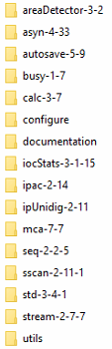
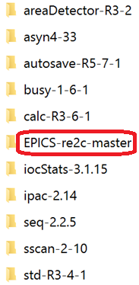
EPICS base version
EPICS 3.15.5
EPICS 7.0.1.1

Slide 3
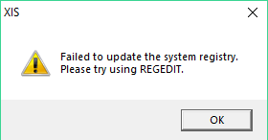
Problems
XIS reports failure updating system registry
Occurs for all drivers/XIS versions. Not sure how it affects image capture. (we can see images in XIS)
Solution: N/A. Need to confirm with Perkin Elmer.

Slide 4
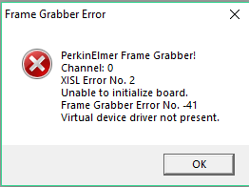
Problems (cont.)
Device failed to initialize
Solution: install the latest driver http://las.perkinelmer.com/downloads/walluf/XIS_Inst_Package_3.3.4.410_16018.zip
perkinElmerSupport/Acq.h
perkinElmerSupport/os/windows- x64/XISL.lib, gbif64.dll, libxml2_x64.dll and XISL.dll
epics> 2018/03/12 11:56:25.893 PerkinElmer::acquireStart, error=19 calling Acquisition_SetTimerSync(hAcqDesc_ =000000000000028C, dwDwellTime=1000000)
2018/03/12 11:56:25.894 PerkinElmer::acquireNormalImage, error=45 calling Acquisition_DefineDestBuffers(hAcqDesc_=000000000000028C, pAcqBuffer_=0000000000000000, numFrames=10, uiRows_=0, uiColumns_=69428256)
PerkinElmerApp: caught exception 0xC0000005 "Access violation"...
(Static-build from Mark River)

Slide 5
Problems (cont.)
(Static-build from Kaz)
Unable to load ADCore\iocBoot\commonPlugins.cmd
Solution: Manually copy EXAMPLE_commonPlugins.cmd to commonPlugins.cmd
Magick disabled
By default, the two lines for Magick configuration (NDFileMagickConfigure and dbLoadRecords) are commented in ADCore\iocBoot\commonPlugins.cmd.
# Create a Magick file saving plugin
#NDFileMagickConfigure("FileMagick1", $(QSIZE), 0, "$(PORT)", 0)
#dbLoadRecords("NDFileMagick.template","P=$(PREFIX),R=Magick1:,PORT=FileMagick1,ADDR=0,TIMEOUT=1,NDARRAY_PORT=$(PORT)")
Solution: uncomment the two lines.

Slide 6
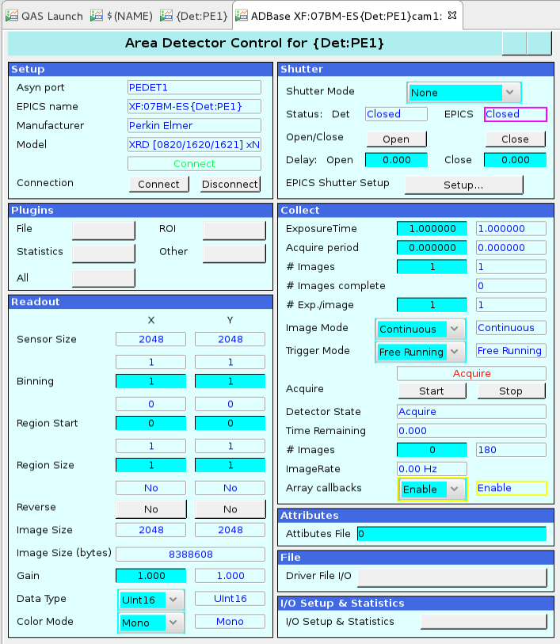
Problems (cont.)
Sometime the IOC doesn't initialize correctly as MaxSizeX/MaxSizeY show 1.
PerkinElmerConfig("PEDET1", 0, "0", 0, 0, 0, 0)
2018/03/15 10:41:17.304 PerkinElmer:: initializeDetector, error=30 calling Acquisition_ GetIntTimes (hAcqDesc_=00000000000002C0, m_pTimingsListBinning=389019968, timings=8)
Error code 30:
HIS_ERROR_SETCAMERAMODE
Setting detector mode failed
Possible solution: pause IOC start for few seconds.

Slide 7
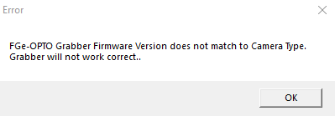
Problems (cont.)
XPD Framegrabber (model/firmware?) + XRO 1611
Solution: The vendor provided wrong product. Will be replaced.

Slide 8
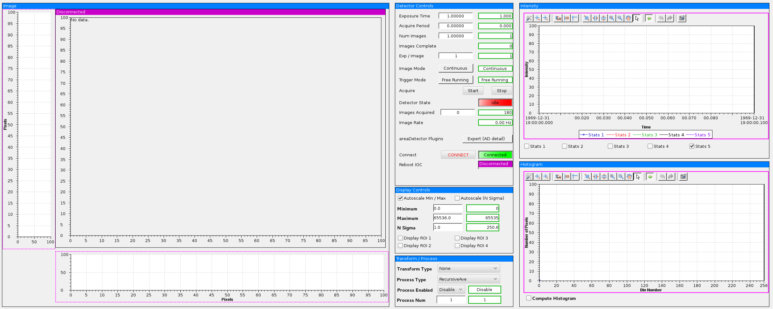
Problems (cont.)
../ADet/3-2/common/color_camera_pva.opi

Slide 9
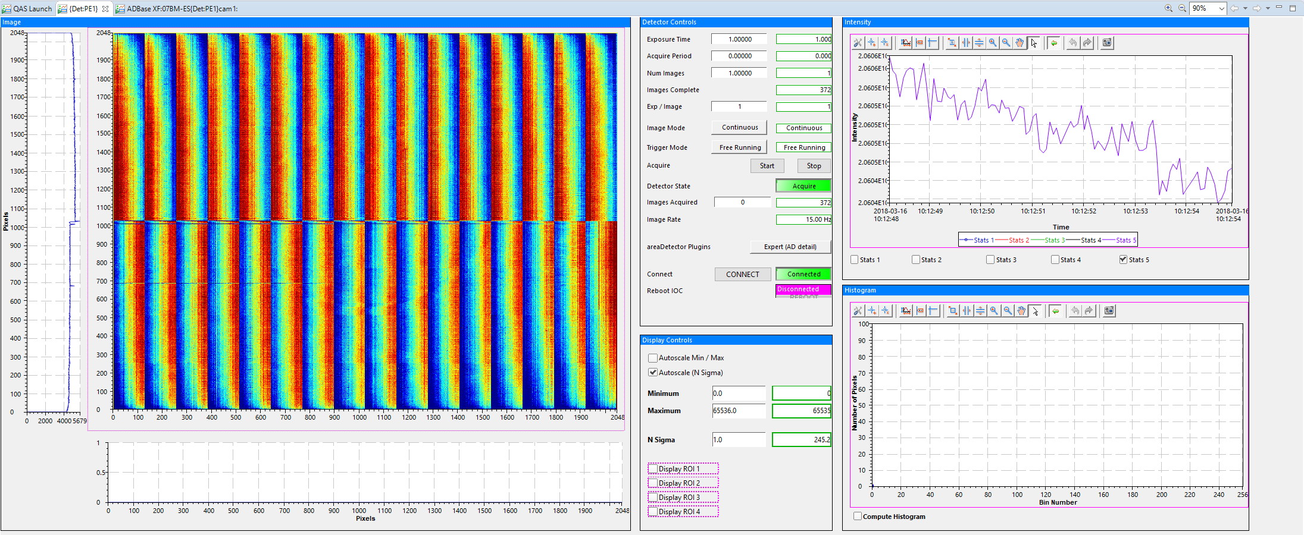
Problems (cont.)
../common/bi/ad_view.opi

Slide 10
Display big images on CSS screen
XRD 1611 produces 4K*4K images, whose size exceed the picture size limitation of CS-Studio (3.15). Nothing will be displayed in CSS screen. (No problem with image acquisition)
To display such Use binning in ROI plugin to reduce the size, and set image1 to get data from port ROI

Slide 11
Future work
XPD Framegrabber + XRO 1611
Calibration at QAS/XPD

